Slide 1
Front End Development
Task-2

Slide 2
Calendar Using HTML, CSS, and JavaScript
LMS Username | Name | Batch
2115a912 | NEERAJ B | A9
2115a95 | MAHESH A | A9
2115a914 | MOHITH C | A9

Slide 3
INTRODUCTION
In full-stack development, front-end development is typically focused on creating the visual and interactive elements of the application that users interact with. Web client-server architecture is responsible for handling user interactions and displaying data.

Slide 4
HTML -
HTML is used to create the structure of web pages; and Bootstrap is a popular CSS framework that provides predefined styles and layout options. JavaScript frameworks provide additional functionality and tools for building complex, interactive user interfaces. They are useful to create responsive, interactive, and efficient user interfaces.
Web client server architecture
HTML Structure Tags – Forms field
Bootstrap – React.Js
jQuery- ajax - Promises
API integration

Slide 5
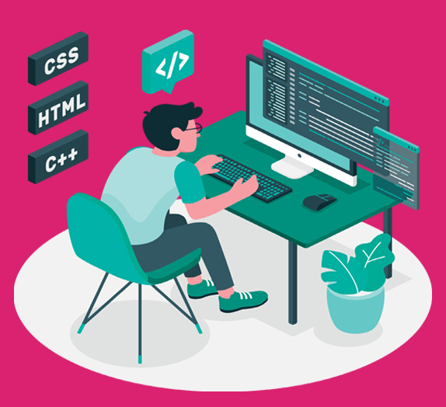
FRONT END DEVELOPMNENT
Developing a user interface webpage by using front end development.
Using HTML & CSS
For example we have developed a learing platform for web development ,etc….called CODETOWN by using “HTML &CSS.

Slide 6
CODETOWN
In this example, the page consists of a header, navigation menu, main content, and footer. The CSS styles are added in the head section of the HTML document.
The header contains the page title, and the navigation menu has links to different sections of the page. The main content contains three sections: About Us, Our Services, and Contact Us. The Contact Us section has a form for users to fill out and submit. The footer contains copyright information.

Slide 7
Algorithm :
Open a text editor like Notepad or Sublime Text on your computer.
Create a new file and save it with the extension ".html". For example, "index.html".
Add the basic HTML structure to the file
In the <title> tag, add a title for your web page. This will appear in the browser tab.
In the <body> tag, add the elements that you want to display on your web page. For example, you can add headings, paragraphs, images, links, forms, and tables.
To add a heading, use the <h1> to <h6>
To add a paragraph, use the <p> tag.
To add an image, use the <img>
To add a link, use the <a> tag.
To add a form, use the <form> tag
To add a table, use the <table> tag with the <tr>, <th>, and <td> tags.
Save the file and open it in a web browser to see how it looks.

Slide 8
SOURCED CODE:
CSS Code For Calendar
body{
background-color: #F5F1E9;
}
#calendar{
margin-left: auto;
margin-right: auto;
width: 320px;
font-family: 'Lato', sans-serif;
}
#calendar_weekdays div{
display:inline-block;
vertical-align:top;
}
#calendar_content, #calendar_weekdays, #calendar_header{
position: relative;
width: 320px;
overflow: hidden;
float: left;
z-index: 10;
}

Slide 9
#calendar_weekdays div, #calendar_content div{
width:40px;
height: 40px;
overflow: hidden;
text-align: center;
background-color: #FFFFFF;
color: #787878;
}
#calendar_content{
-webkit-border-radius: 0px 0px 12px 12px;
-moz-border-radius: 0px 0px 12px 12px;
border-radius: 0px 0px 12px 12px;
}
#calendar_content div{
float: left;
}
#calendar_content div:hover{
background-color: #F8F8F8;
}

Slide 10
#calendar_content div.blank{
background-color: #E8E8E8;
}
#calendar_header, #calendar_content div.today{
zoom: 1;
filter: alpha(opacity=70);
opacity: 0.7;
}
#calendar_content div.today{
color: #FFFFFF;
}
#calendar_header{
width: 100%;
height: 37px;
text-align: center;
background-color: #FF6860;
padding: 18px 0;
-webkit-border-radius: 12px 12px 0px 0px;
-moz-border-radius: 12px 12px 0px 0px;
border-radius: 12px 12px 0px 0px;
}

Slide 11
#calendar_header h1{
font-size: 1.5em;
color: #FFFFFF;
float:left;
width:70%;
}
i[class^=icon-chevron]{
color: #FFFFFF;
float: left;
width:15%;
border-radius: 50%;
}

Slide 12
HTML Code For Calendar
<!DOCTYPE html>
<html lang="en">
<head>
<meta charset="UTF-8" />
<meta http-equiv="X-UA-Compatible" content="IE=edge" />
<meta name="viewport" content="width=device-width, initial-scale=1.0" />
<title>calendar</title>
<link rel="stylesheet" href="style.css">
<link rel="stylesheet" href="https://fonts.googleapis.com/css?family=Lato">
<link rel="stylesheet" href="https://netdna.bootstrapcdn.com/font-awesome/3.2.1/css/font-awesome.css">
</head>
<body>
<div id="calendar">
<div id="calendar_header">
<i class="icon-chevron-left"></i>
<h1></h1>
<i class="icon-chevron-right"></i>
</div>
<div id="calendar_weekdays"></div>
<div id="calendar_content"></div>
</div>
<!-- JAVASCRIPT -->
<script src="https://cdnjs.cloudflare.com/ajax/libs/jquery/2.1.3/jquery.min.js"></script>

Slide 13
<script src="app.js"></script>
</body>
</html>
Javascript code For Calendar
$(function () {
function c() {
p();
var e = h();
var r = 0;
var u = false;
l.empty();
while (!u) {
if (s[r] == e[0].weekday) {
u = true;
} else {
l.append('<div class="blank"></div>');
r++;
}
}
for (var c = 0; c < 42 - r; c++) {

Slide 14
if (c >= e.length) {
l.append('<div class="blank"></div>');
} else {
var v = e[c].day;
var m = g(new Date(t, n - 1, v)) ? '<div class="today">' : "<div>";
l.append(m + "" + v + "</div>");
}
}
var y = o[n - 1];
a.css("background-color", y)
.find("h1")
.text(i[n - 1] + " " + t);
f.find("div").css("color", y);
l.find(".today").css("background-color", y);
d();
}
function h() {
var e = [];
for (var r = 1; r < v(t, n) + 1; r++) {
e.push({ day: r, weekday: s[m(t, n, r)] });

Slide 15
}
return e;
}
function p() {
f.empty();
for (var e = 0; e < 7; e++) {
f.append("<div>" + s[e].substring(0, 3) + "</div>");
}
}
function d() {
var t;
var n = $("#calendar").css("width", e + "px");
n.find((t = "#calendar_weekdays, #calendar_content"))
.css("width", e + "px")
.find("div")
.css({
width: e / 7 + "px",
height: e / 7 + "px",
"line-height": e / 7 + "px",
});
n.find("#calendar_header")

Slide 16
.css({ height: e * (1 / 7) + "px" })
.find('i[class^="icon-chevron"]')
.css("line-height", e * (1 / 7) + "px");
}
function v(e, t) {
return new Date(e, t, 0).getDate();
}
function m(e, t, n) {
return new Date(e, t - 1, n).getDay();
}
function g(e) {
return y(new Date()) == y(e);
}
function y(e) {
return e.getFullYear() + "/" + (e.getMonth() + 1) + "/" + e.getDate();
}
function b() {
var e = new Date();
t = e.getFullYear();
n = e.getMonth() + 1;
}

Slide 17
var e = 480;
var t = 2013;
var n = 9;
var r = [];
var i = [
"JANUARY",
"FEBRUARY",
"MARCH",
"APRIL",
"MAY",
"JUNE",
"JULY",
"AUGUST",
"SEPTEMBER",
"OCTOBER",
"NOVEMBER",
"DECEMBER",
];
var s = [
"Sunday",
"Monday",

Slide 18
"Tuesday",
"Wednesday",
"Thursday",
"Friday",
"Saturday",
];
var o = [
"#16a085",
"#1abc9c",
"#c0392b",
"#27ae60",
"#FF6860",
"#f39c12",
"#f1c40f",
"#e67e22",
"#2ecc71",
"#e74c3c",
"#d35400",
"#2c3e50",
];

Slide 19
var u = $("#calendar");
var a = u.find("#calendar_header");
var f = u.find("#calendar_weekdays");
var l = u.find("#calendar_content");
b();
c();
a.find('i[class^="icon-chevron"]').on("click", function () {
var e = $(this);
var r = function (e) {
n = e == "next" ? n + 1 : n - 1;
if (n < 1) {
n = 12;
t--;
} else if (n > 12) {
n = 1;
t++;
}
c();
};
if (e.attr("class").indexOf("left") != -1) {

Slide 20
r("previous");
} else {
r("next");
}
});
});

Slide 21
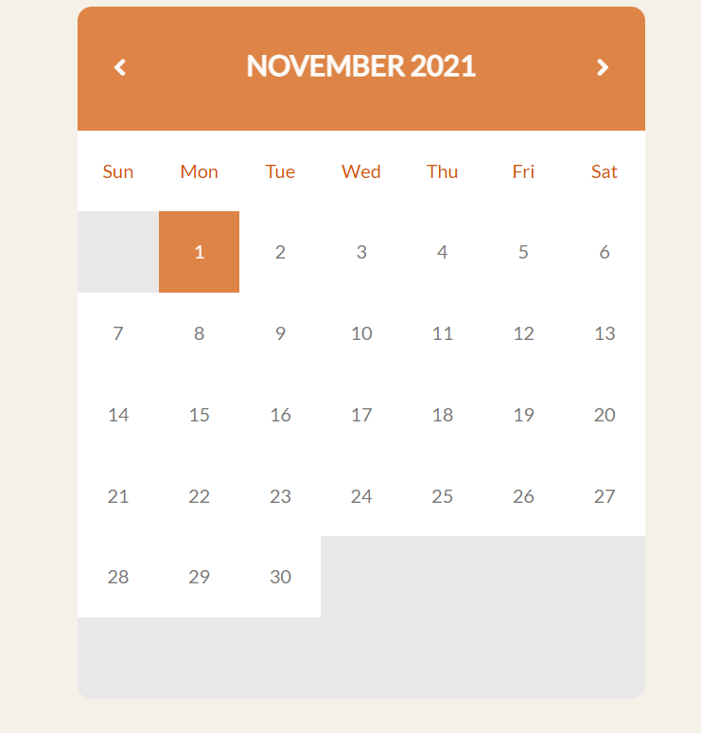
Sample Output:

Slide 22
In conclusion, front-end development is a critical aspect of web development that involves designing and developing the visual and interactive components of a website. It requires knowledge of HTML, CSS, and JavaScript, as well as an understanding of user experience (UX) and user interface (UI) design principles.
The front-end developer is responsible for creating an engaging user experience by designing and implementing the layout, typography, color schemes, and graphics of a website. They also ensure that the website is responsive and accessible across multiple devices and platforms.

Slide 23
Front-end development is a constantly evolving field, with new technologies and frameworks emerging regularly. Therefore, it is crucial for front-end developers to keep up with the latest trends and developments in the industry to create modern and functional websites that meet the needs of users and businesses alike.

Slide 24
In summary, front-end development plays a crucial role in creating visually appealing and engaging websites that attract and retain users. With the right skills and knowledge, front-end developers can create effective user interfaces that provide an exceptional user experience, thereby contributing to the success of a website and its business.

Slide 25
Submission Github
https://github.com/AmmapalleMahesh/front-end-development-for-calender/blob/826548e6586fee1f7b8df12ef13c009320df636d/README.md

Slide 26


